Slide 1
Introduction to Computer Vision – 22928 Final Project 2022a
Font Recognition
Submission Date:
13.01.2022

Slide 2







Identify 7 fonts in “real” imaged:

Slide 3
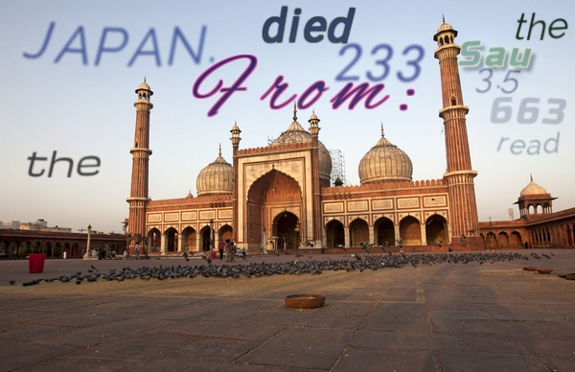

Slide 4
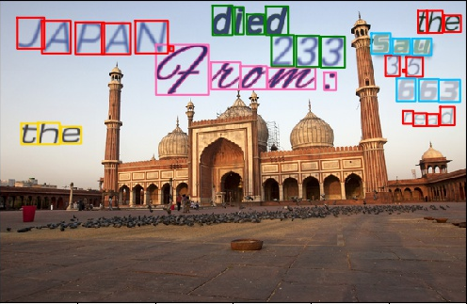

Slide 5
The Challenge
Your goal is to correctly recognize the font for each character in each image.
Train set – images and labels:
https://drive.google.com/drive/folders/1jzHYpTwywUYA53nMGHVROSuVO14hEueq?usp=sharing
Test set – will be hidden until the last days of the challenge.
Develop a model.
Document it and report performance.

Slide 6
Where to start
Download the training set from:
https://drive.google.com/drive/folders/1jzHYpTwywUYA53nMGHVROSuVO14hEueq?usp=sharing
Zip file contain h5 file with all the data + image folder (just for visualization and debug).
Dataset has 973 Images, 28197 Characters from 7 fonts.
In addition to the images, each image has:
Word bounding boxes.
Character bounding boxes.
Text
Font label for each character

Slide 7
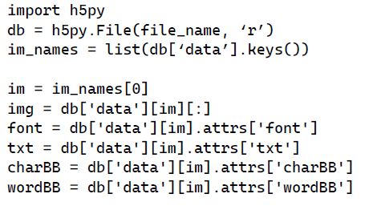
How to read the dataset
Install h5py (pip install h5py – or with anaconda)

Slide 8
About the dataset
Created using the code at –
https://github.com/ankush-me/SynthText
You may create additional training images.

Slide 9
Develop
Use any of the methods learned in class.
Use any method you can find a description for in any paper.
Implement it yourself in Python.
Including OpenCV and scikit-learn
Any other package need to be approved.
DO NOT USE UNAUTHORIZED CODE

Slide 10
Document - Report
Write a detailed document explaining you method:
No more than 10 pages.
PDF
Show results.
Code must be stand alone (and running).
Pickle file with the final model.
Document must cover all aspects of your work.

Slide 11
Grading
Accuracy (how well did you do)
Performance (how fast do you do it).
Novelty (how new is you idea).
May build on existing ideas and still be novel.
Documents and code organization.
Final grade is on a curve – if you are worst (your methods performs worst), you’ll get the worst grade and it will be low.

